Slide 1


Evidence that Robots Trigger a Cheating Detector in Humans
Alexandru Litoiu, Daniel Ullman, Jason Kim, and Brian Scassellati
Social Robotics Lab
Yale University

Slide 2
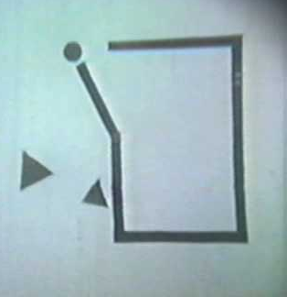
Attributions of Agency
Low-level perceptions of movement generate attributions of intentionality
Interested in generating intentionality from top-down cognitive effects
Heider and Simmel, The American Journal of Psychology, 1944
Notes:
*Rock-paper-scissors
*The paper I will present today disambiguates a confound in that study

Slide 3
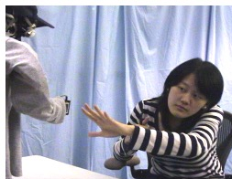
Cheating Robots Are More Engaging
Short et al. showed that a cheating robot:
Rock-paper-scissors
Has more intentions and desires
“Sneaky bastard”
Results were clear, but explanation was not
Short E, Hart J, Vu M, Scassellati B. No Fair!! An Interaction with a Cheating Robot. The 5th ACM/IEEE International Conference on Human-Robot Interaction. (2010).
Notes:
*Rock-paper-scissors
*The paper I will present today disambiguates a confound in that study

Slide 4
Possible Causes of Effects (Short et al.)
Condition | Utterance | Behavior
Verbal Cheat | Incorrect “Yes, I win” | Correct
Malfunction
Action Cheat | Incorrect “Yes, I win” | Changed gesture to win
Cheat, Agency
What is the cause of extra attributions in the action cheat?
Added complexity of the motion?
Cheating effect?

Slide 5
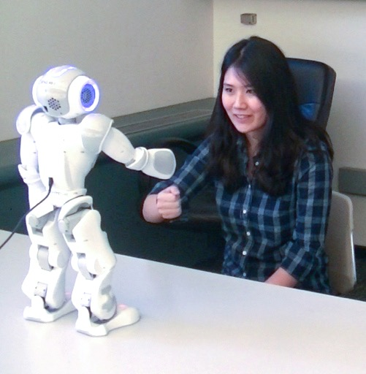
Main Design
Maintain amount of motion between conditions
Vary the “directionality” of cheat from adversarial to prosocial
Notes:
*Maintained the amount of motion between all conditions. We kept this constant to remove the confound.
*In every condition, the robot made some extra motion in order to break the rules
*Break the rules to throw the game, to let the participant win
*Break the rules in some more neutral way

Slide 6



Experimental Conditions
PARTICIPANT THROWS
WIN
DRAW-UP
DRAW-DOWN
LOSE
ROBOT WINS
ROBOT DRAWS
ROBOT LOSES
ADVERSARIAL
PROSOCIAL
Notes:
Important to also have more neutral conditions
Draw-up is less adversarial than WIN, as it has less of a magnitude. It is a little bit adversarial, but mostly neutral, as the participants end up in a DRAW.

Slide 7
Experimental Details
83 participants
Between-participant design
30 rounds of rock-paper-scissors
2 cheat occurrences in the “Cheating Rounds”
ROUND #
1
10
20
30
ROUND TYPE
Control Rounds
Cheating Rounds
Control Rounds
15 Minutes

Slide 8
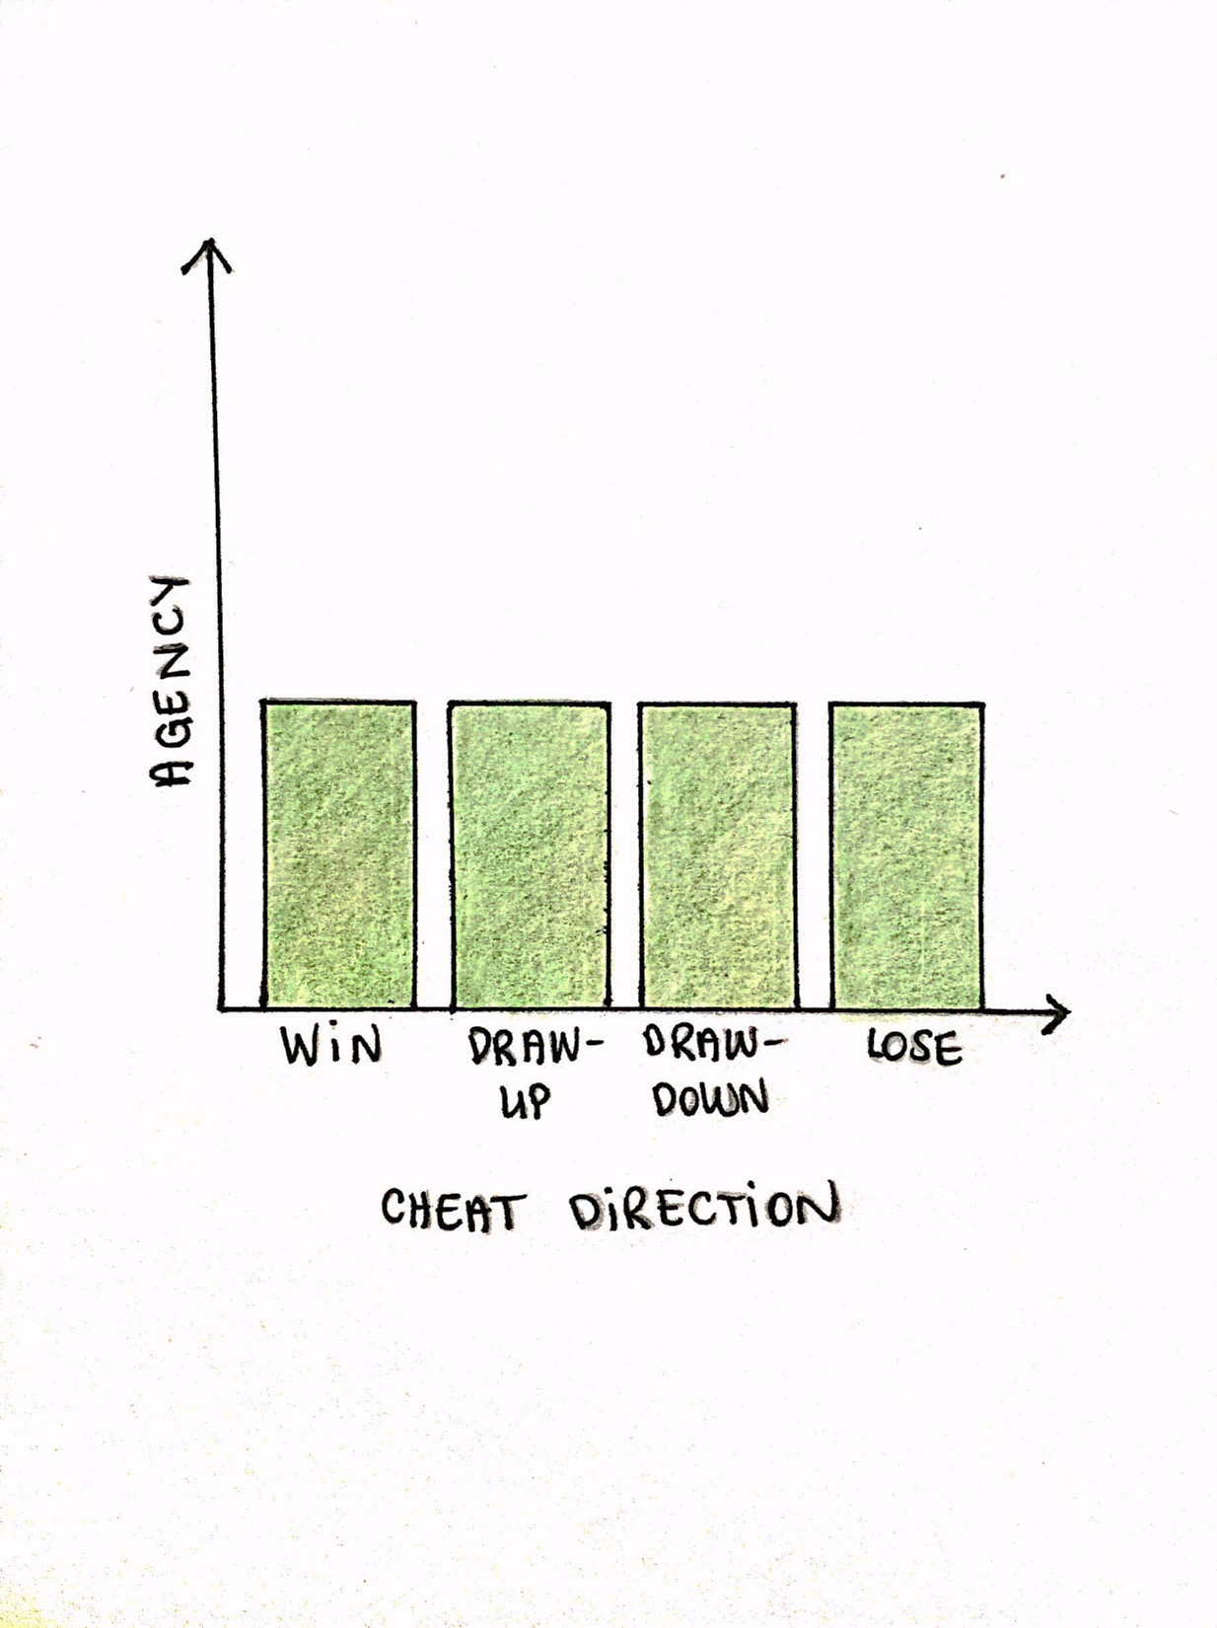
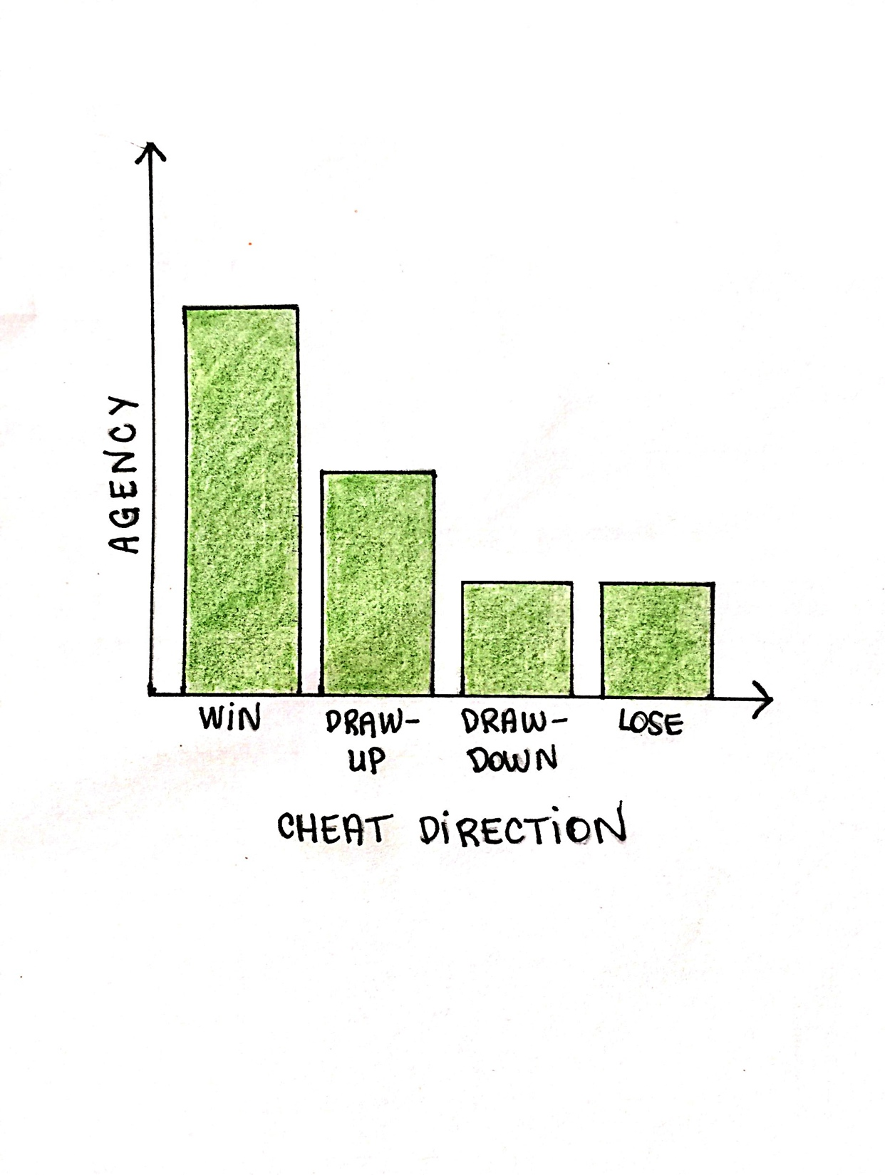
Expectations of Results
If the cause is a high-level cognitive effect…
If the cause is motion…

Slide 9
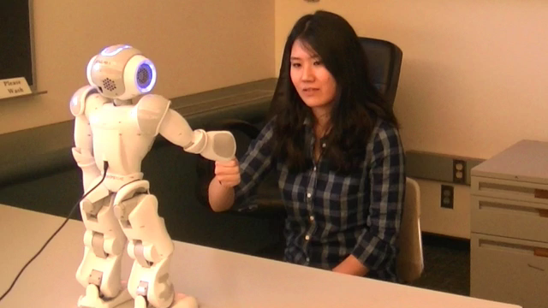
Participant Reactions

Slide 10
Participant Engagement
Emitted an Utterance Following Gesture Change
Baseline utterance prevalence in non-cheating rounds
* represents p < 0.05, ** represents p < 0.01, *** represents p < 0.001. Error bars represent standard error.

Slide 11
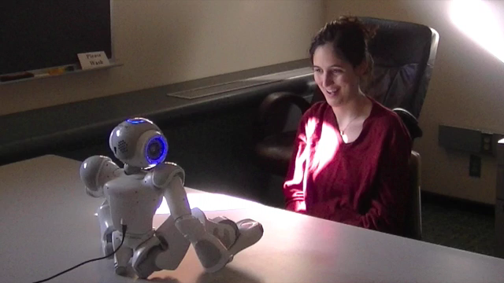
Lasting Effects

Slide 12
Cheat Salience
Volunteered that the Robot Changed its Gesture in the Post-Study Response
* represents p < 0.05, ** represents p < 0.01, *** represents p < 0.001. Error bars represent standard error.

Slide 13
Attributions – Fairness and Honesty
“Fair” Likert Question
“Honest” Likert Question
* represents p < 0.05, ** represents p < 0.01, *** represents p < 0.001. Error bars represent standard error.

Slide 14
Evidence that Robots Trigger a Cheating Detector in Humans
Cause of effect in Short et al.
Not the added complexity of the motion
Not the rule-breaking behavior
Instead, it is specifically the adversarial cheat
In line with expected results of cheating detector that is triggered by robots
Cosmides, Cognition, 1989
Van Lier et al., PLOS ONE, 2013
Notes:
So, our results clearly show that it was not the bottom-up perceptual cue of the added motion that caused the attributions of agency. If it had been, we would have seen all of our conditions see uniform results. Instead, it is a top-down cognitive effect that caused this agency as a result of the participant specifically being cheated out of something.
Much work has shown that humans possess an evolutionary cheating detector that is triggered by other humans socially cheating them out of something. Our results are entirely in line with what we would expect if that same cheating detector was triggered by robots.

Slide 15
Thank You! More Results and Questions at Poster Session

